Slide 1
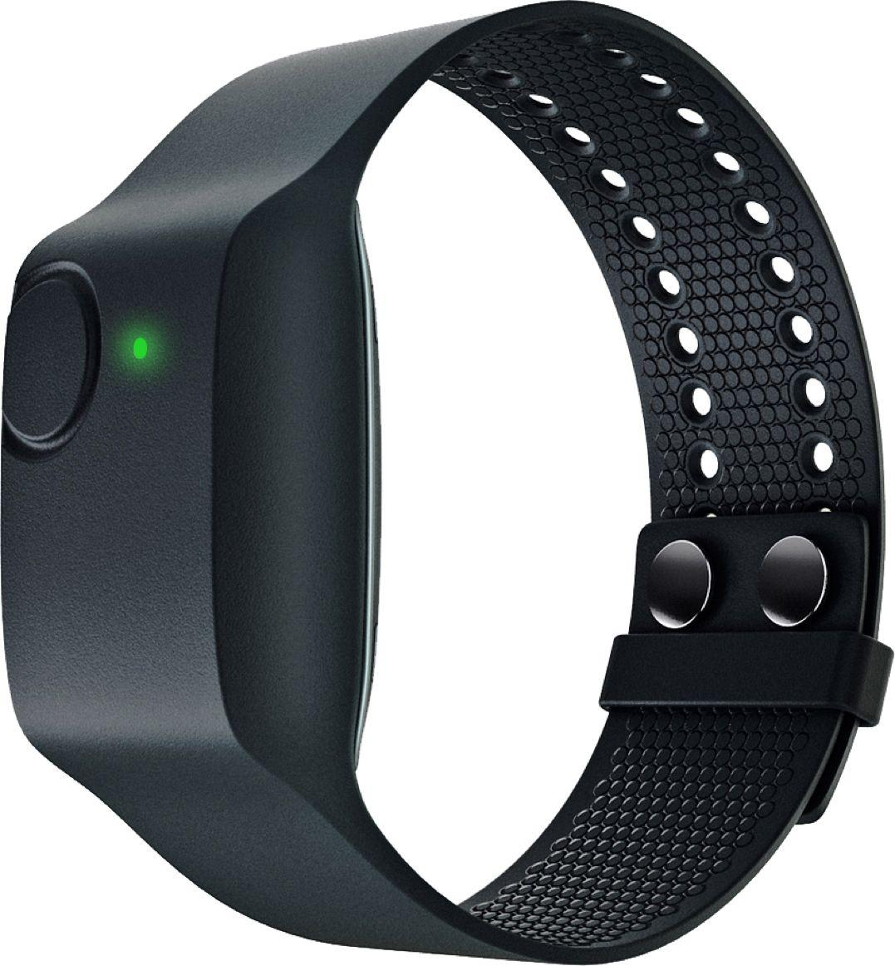
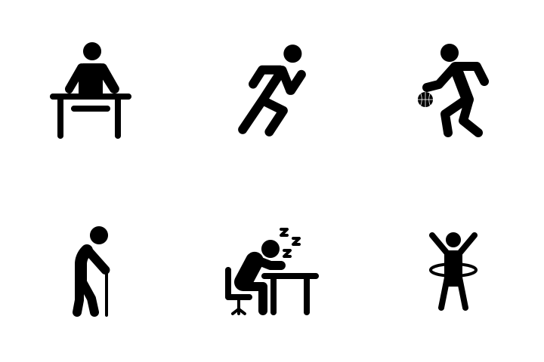


Team 4: Human Activity Recognition Using Physiological Data from Wearables
Team: Kush Gulati, Annie Hirsch, Noah Lanier, Nathan Warren
Project Manager: Brinnae Bent
Project Lead: Dr. Jessilyn Dunn
Notes:
Noah

Slide 2

CURRENT PROGRESS
Weeks 1-2
Week 3
Week 4
Week 5
Week 6
Domain Research & Literature Review
Exploratory Data Analysis
Preprocessing & Traditional ML
Deep Learning: CNN-LSTMs
Deep Learning: Multilayer Perceptron
Notes:
Looking at our progress so far, we have completed an extensive domain research & literature review, delved into our data in EDA, did some time series preprocessing to test a baseline machine learning model on our data. In the past two weeks, we have been working hard on testing both simple and complex deep learning models, which we will discuss later in the presentation.

Slide 3

HUMAN ACTIVITY RECOGNITION
Human activity recognition (HAR) is the automatic recognition of physical activities through wearable devices that monitor mechanical and physiological states over time.
Notes:
Noah

Slide 4
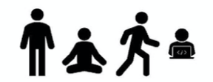
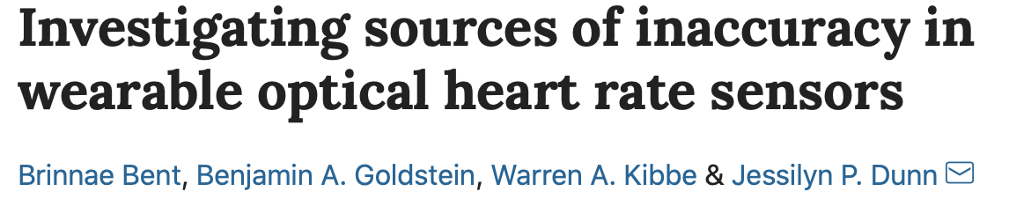
THE ACTIVITIES
Notes:
Kush
Our data was collected from research on [Investigating sources of inaccuracy in wearable optical heart rate sensors]. 56 participants completed rest, deep breathing, walking, and typing and we are using the data collected from the empatica research grade variable.

Slide 5
THE SENSORS
Blood Volume Pulse/HR (Physiological)
Electrodermal Activity (Physiological)
Skin Temperature (Physiological)
3-Axis Accelerometer (Mechanical)
Notes:
The four sensors that we are using from the Empatica E4 wearable device are Blood Volume Pulse, Electrodermal Activity, Skin Temperature, and a 3-axis accelerometer. Note that most HAR experiments do not include physiological sensors, so we are interested in seeing whether incorporating them adds any information gain to our predictive model.

Slide 6
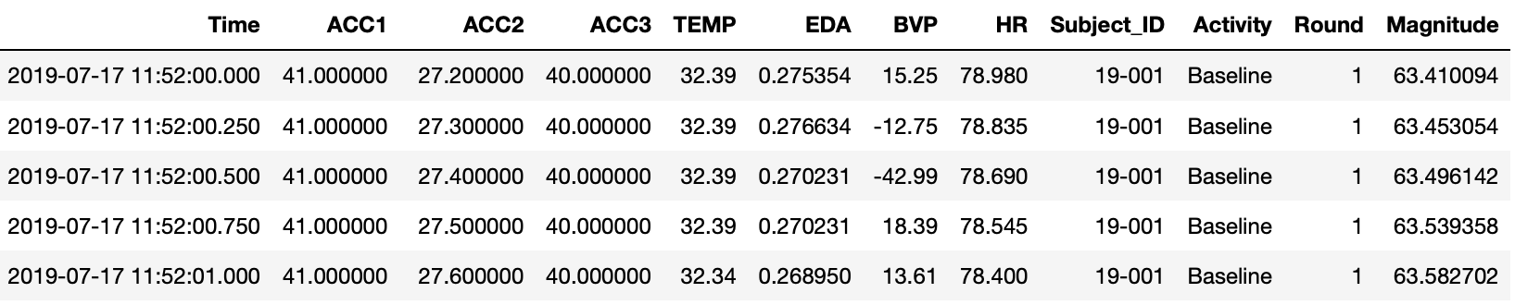
THE DATA
5288 rows for each of the 56 Subjects (approximately 22 minutes per subject)
All sensors sampled at 4 Hz (every 0.25 seconds)
Notes:
This is an example of what a sample of 5 rows of our data looks like after some cleaning and preparation. There are 5288 rows for each of the 56 subjects, representing approximately 22 minutes of data for each subject. All of our samples were sampled at 4 Hertz, recording a data point every 0.25 seconds. We also constructed a Magnitude feature to calculate the length of the ACC vector from its x, y, and z components denoted as ACC1, 2, and 3 respectively. Also, 1 and 2, in the activity feature refer to the first and second rounds of data collection in the experiment.

Slide 7
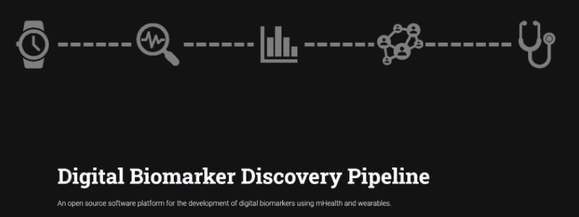
MAIN OBJECTIVE
Classify activity (rest, deep breathing, walking, typing) at high accuracy and precision
Assess efficacy of including physiological sensor data with accelerometry data (performance and generalization)
Notes:
We aspire to make our work open source, as a part of an overarching digital biomarker discover pipeline, as part of the Big Ideas lab at Duke

Slide 8

EXPLORATORY DATA ANALYSIS
Notes:
Let’s take a look at our Exploratory Data Analysis.

Slide 9
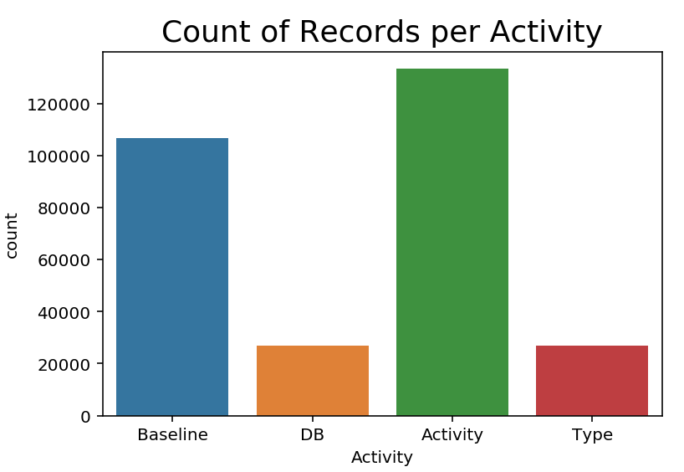

CLASS DISTRIBUTION
Baseline: 4 Minutes
Deep Breathing: 1 Minute
Activity: 5 Minutes
Type: 1 Minute
*Each activity completed for 2 rounds, resulting in about 22 minutes of data per subject*
Notes:
Class imbalance
As you can see in the bar chart to the left, The minority classes (DB and Typing) are harder to predict because there are few examples of this class, by definition. This means it is more challenging for a model to learn the characteristics of examples from this class, and to differentiate examples from this class from the majority class (or classes). The abundance of examples from the majority class (or classes) can swamp the minority class in a classification model.
We have thought of some methods to combat class imbalance, including usage of class weighted metrics, different cross-validation techniques, and resampling which we will discuss later.

Slide 10
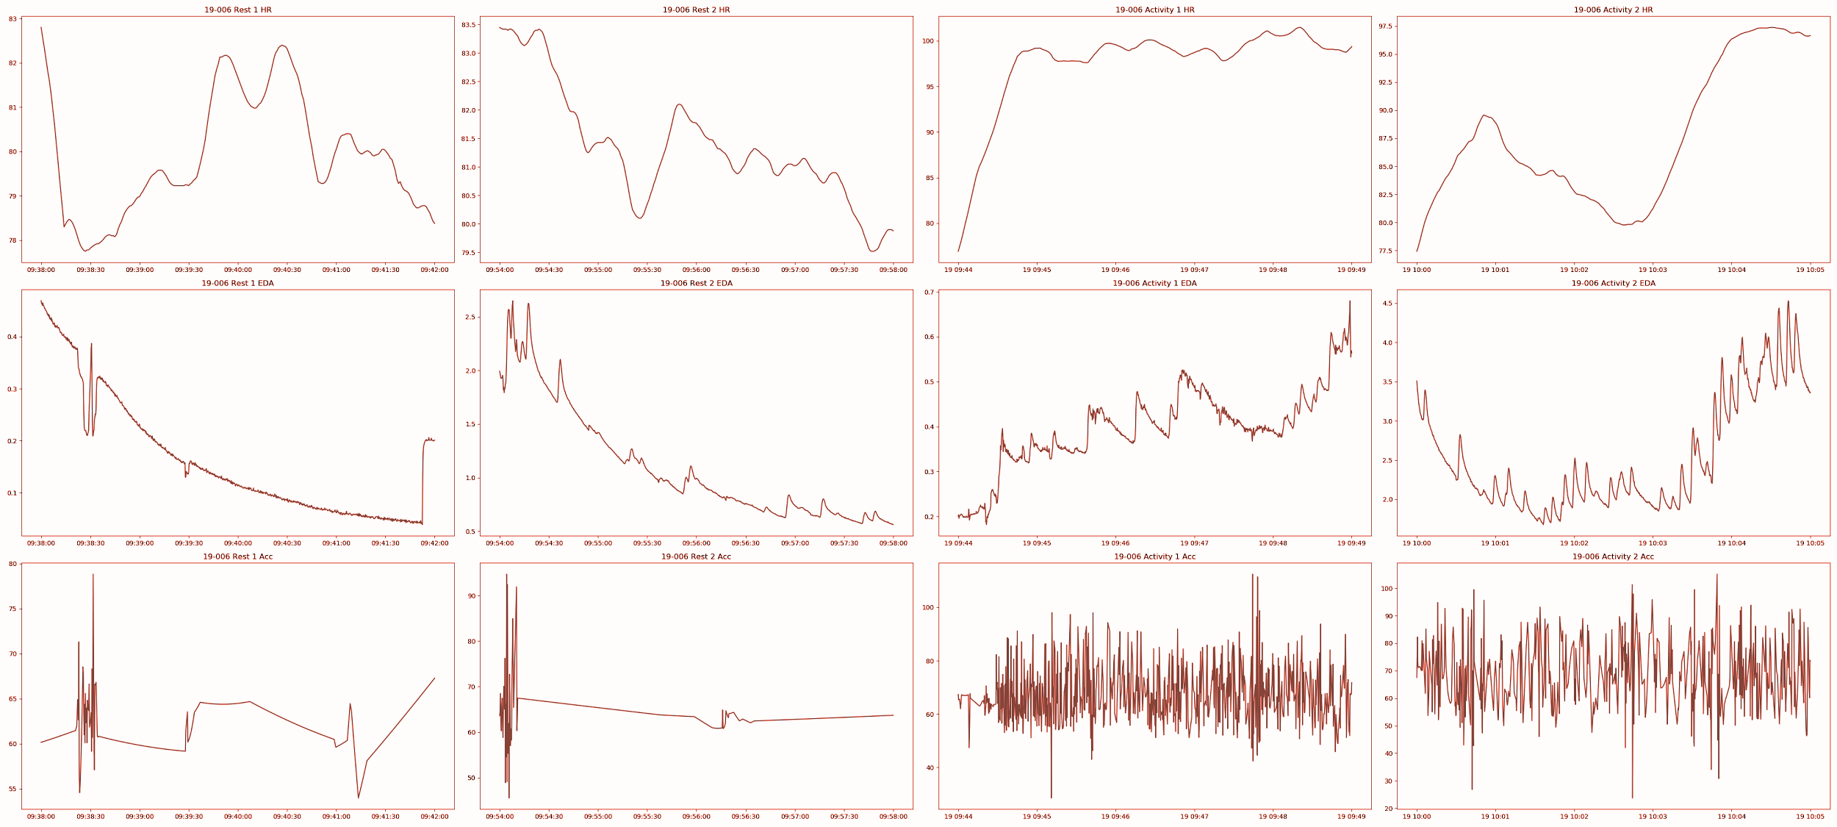
Rest
Activity
HR
EDA
ACC Mag.
Notes:
Our EDA was centered around getting acclimated to the sensor data and visualizing what made the physiological sensors data different to answer this main research question of whether physiological sensors improve HAR models. Here is an example of what we showed to the Data+ cohort.
This EDA helped our team decide how we wanted to
Preprocess our data
Select models
Preprocessing methods allow us to try different models - for example, rolling lends itself better to a MLP and sliding windows lends itself better to a 1D CNN (we’ll talk about this more later in the presentation), which each have different ways of extracting features unique to each sensor.

Slide 11
EDA TAKEAWAYS
CLASS IMBALANCE
ROUND VARIABILITY
OUTLIER REMOVAL
INTERCLASS VARIABILITY
Some activities were performed longer than others, and for 2 rounds
Round 2 may contain ‘side effects’ from Round 1, causing good variation
There were no data points with impossible readings
Both imperfect data and the fact that people perform the same action differently adds variation
Notes:
As a lot of exploratory data analyses do, our EDA brought to light a lot of issues driven by data quality and experimental design. As mentioned earlier, this dataset was used in Brinnae’s investigating heart rate sensors paper, and in our EDA we became issues of things we needed to account for in our model building. First, class imbalance was an issue in both the amount time spent and selection of activities that were performed the most. Second, the experimental design meant that there would be round variability. Data variability may also contribute to interclass variability. The model learns multiple ways to classify the same activity, adding to generalizability and reducing overfitting
But, without this experimental design that is unorthodox for HAR, we may not have been trying to answer our research question of whether physiological data is effective in HAR, and we are encouraged to build a module that is more universal to other activity datasets that may use the DBDP.

Slide 12

TRADITIONAL MACHINE LEARNING
Notes:
Moving onto Traditional Machine Learning, our objective in this section was to create a baseline classifier model before trying to develop more complex deep learning solutions.

Slide 13
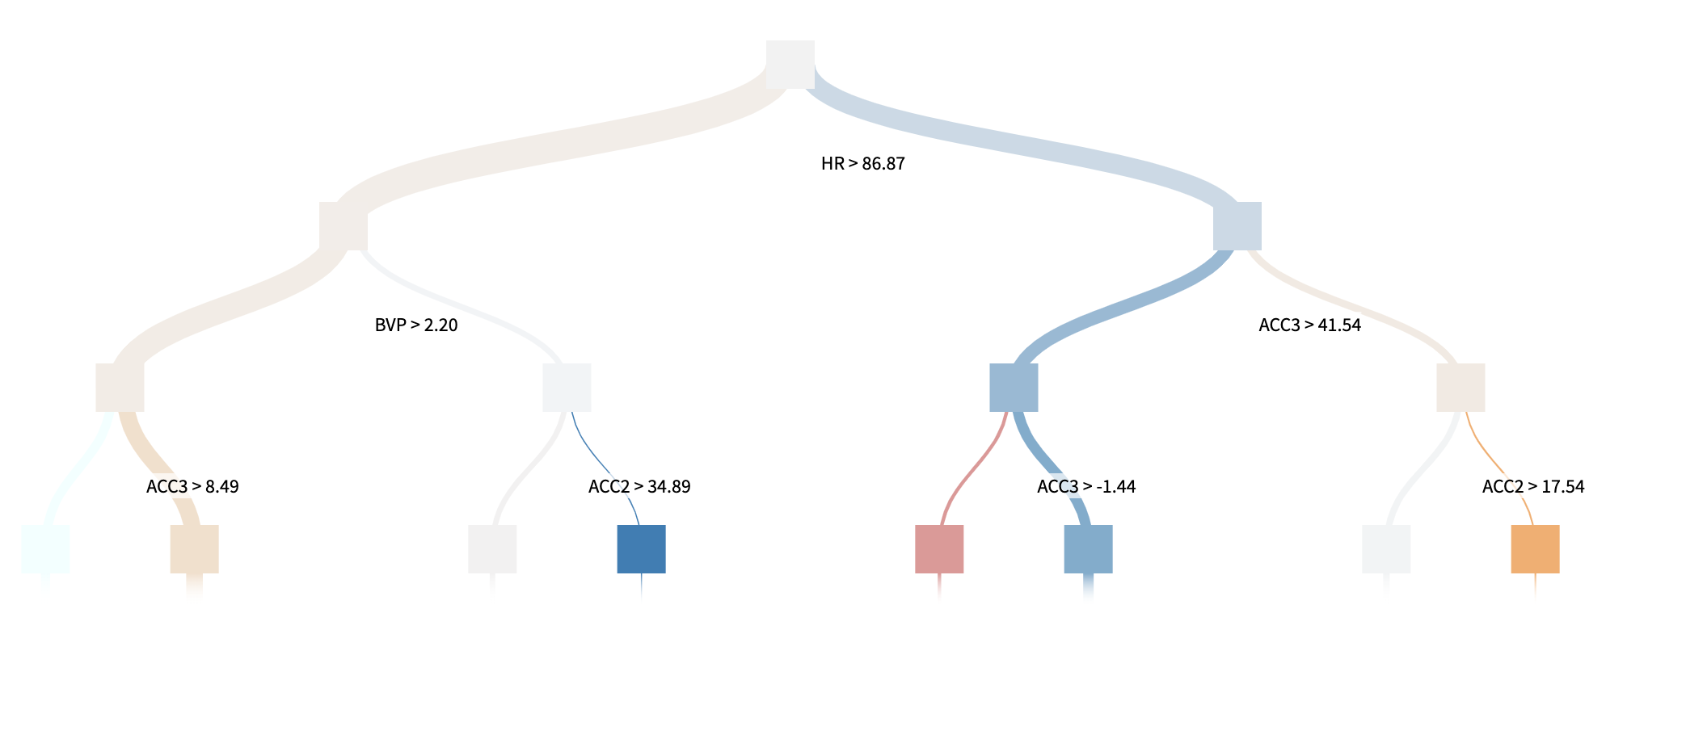

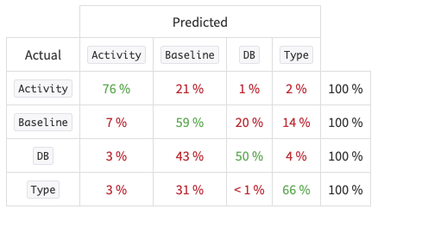
RANDOM FOREST
F1: 0.5893
Acc: 0.6678
Feature | ACC3 | ACC2 | ACC1 | TEMP | EDA | Magnitude | HR | BVP
Importance | 25% | 22% | 16% | 10% | 9% | 8% | 7% | 3%
Notes:
We decided to use a ensemble learning Random Forest Classifier which is a set of 100 decision trees from randomly selected subsets of our data.
A rolling analysis of a time series model is often used to capture our sensor instability over time, which is what we used to compute feature estimates as our input to this random forest model. We split our data by subject, putting 45 random subjects into the train set and 11 in the test set. Our results show an extensive importance to the accelerometer data, encapsulating over 60% of the variable importance which makes sense because it is usually the only sensor included in HAR experiments. Also, we saw that Activity classification has the most accuracy, which also makes sense because it is the most distinguishable from the other three classifications in terms of physiological movement.

Slide 14
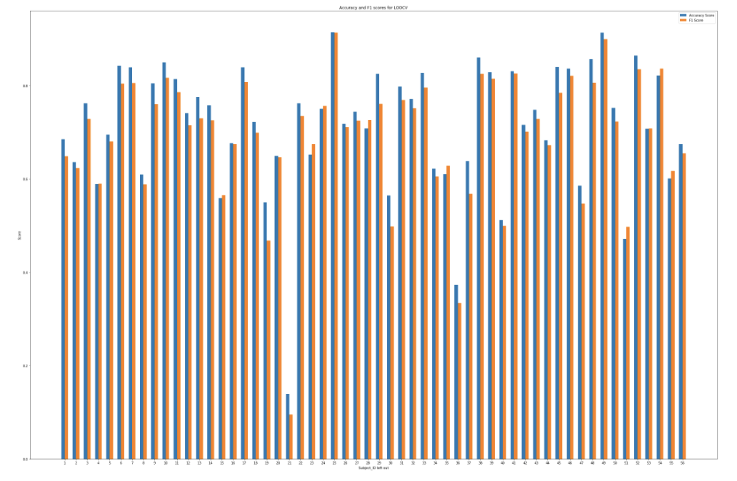
LEAVE-ONE-OUT CROSS-VALIDATION
Each individual subject considered as a validation set and the rest of subjects are a training set
Fit the model and predict using single-subject validation
Repeat this for each subject as a validation set.
Average all errors to obtain test-error rate
 | ACCURACY | F1
Mean | 0.7131 | 0.6914
Std | 0.1395 | 0.1402
IDs 21 & 36 → Low Accuracy
Notes:
Moving from Dataiku where we built our initial random forest, we wanted to try LOOCV on our data in Python. In Leave One out CV, the model is fit on 55 subjects, and predicts on the 1 remaining subject. We repeated this for 56 times for each observation as a validation set, and out test-error rate is average of all n errors. We found that our accuracy improved as shown in the table, and the graph on the left tells us that particular subjects are bringing the overall accuracy of the model down with especially low accuracy in LOOCV.

Slide 15

DEEP LEARNING
Notes:
We decided to use deep learning to see if we could create a model that performed better than our random forest. The idea behind this is that deep learning allows for the creation and usage of features not apparent to us.

Slide 16
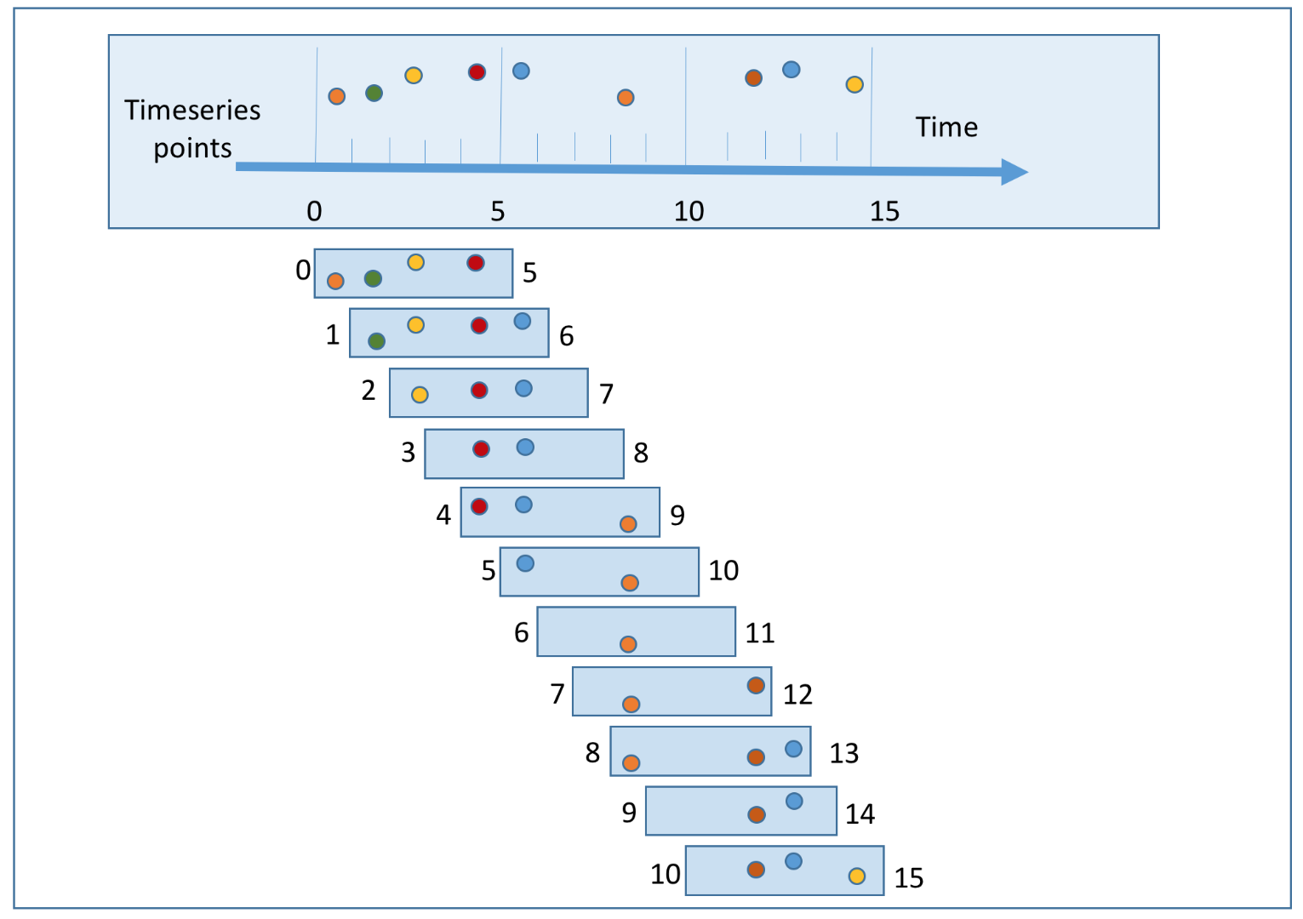
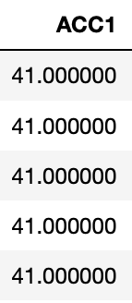
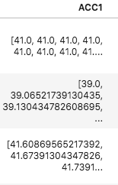
SLIDING-WINDOW PROCESSING
Direct inputs
to neural network
Notes:
Why sliding window?
Able to get features of each time interval within activity (e.g., heart rate increasing during activity)
Other alternatives include rolling, but are not as granular
We would then be classifying over a sequence of time points rather than individual rows of data
Our data is processed as sliding windows for input into one of our models. By processing the sequential timepoints into windows, we are able to use patterns present in these windows as features for each activity in our model.

Slide 17
DEEP LEARNING MODELS
Model Name | Data Input | Accuracy | F1 Score
Feedforward NN | Individual Timepoints | 0.89 | 0.89
CNN-RNN | Sliding Window | 0.46 | 0.62
Sliding Window supports time-series data and time-based features.
Notes:
We have created two deep learning models. The first is a simple feedforward neural net which takes in individual timepoints and passes the data through multiple hidden dense layers. With this model we were able to achieve an accuracy of 0.89 and an F1 score of 89. While this type of model is efficient in classifying the data we have, it may not be generalizable to other human activity recognition datasets. It also is unable to capture time-relevant features as sensors readings change during the course of an activity.
To remedy this, we created a hybrid CNN-RNN model. The model we are using is able to take in windows of any size, but for this model we used 10 second windows with no overlap. With this model we were able to achieve an accuracy of 0.46 and a F1 score of 0.62. To explain how this model works, let's quickly look at it’s architecture.

Slide 18
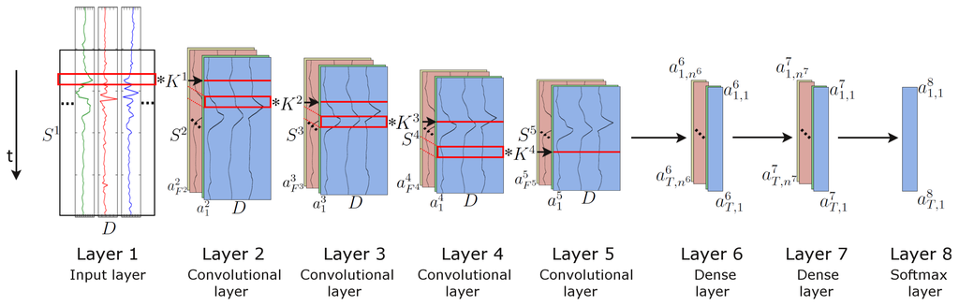
CNN-RNN ARCHITECTURE
Tensorflow DenseNet
Individual Rows
PyTorch CNN-RNN
Tensorflow CNN-RNN with Time Distributed Layers
Sliding Window
LSTM layer
LSTM layer
Notes:
As the windowed data is passed through the model, convolution allows the model to extract features local to each window. As these features are then passed through our long short term memory nodes, the RNN is able to extract temporal features. The combination of these local window features and time-dependent features should allow us to achieve better classification and a more generalizable model.

Slide 19
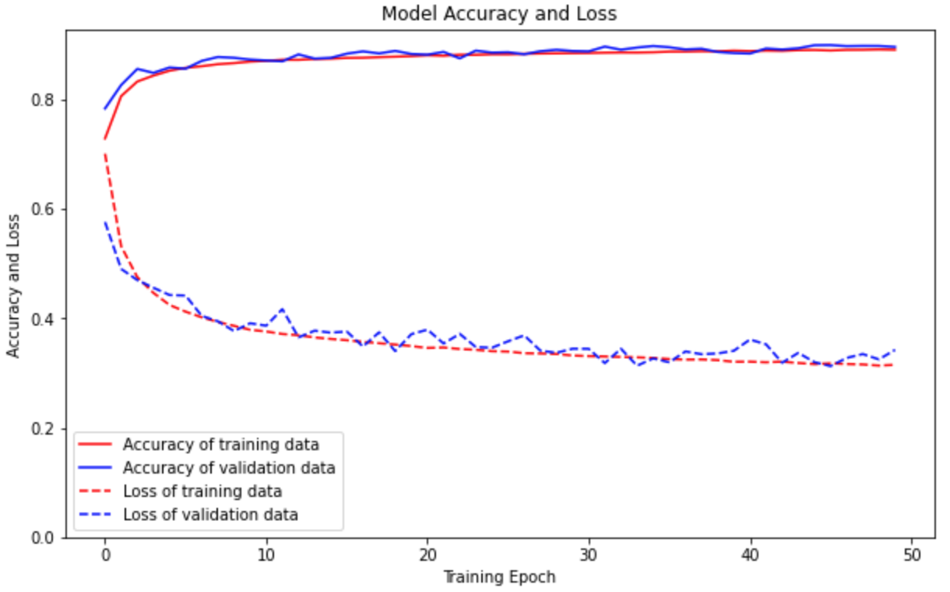
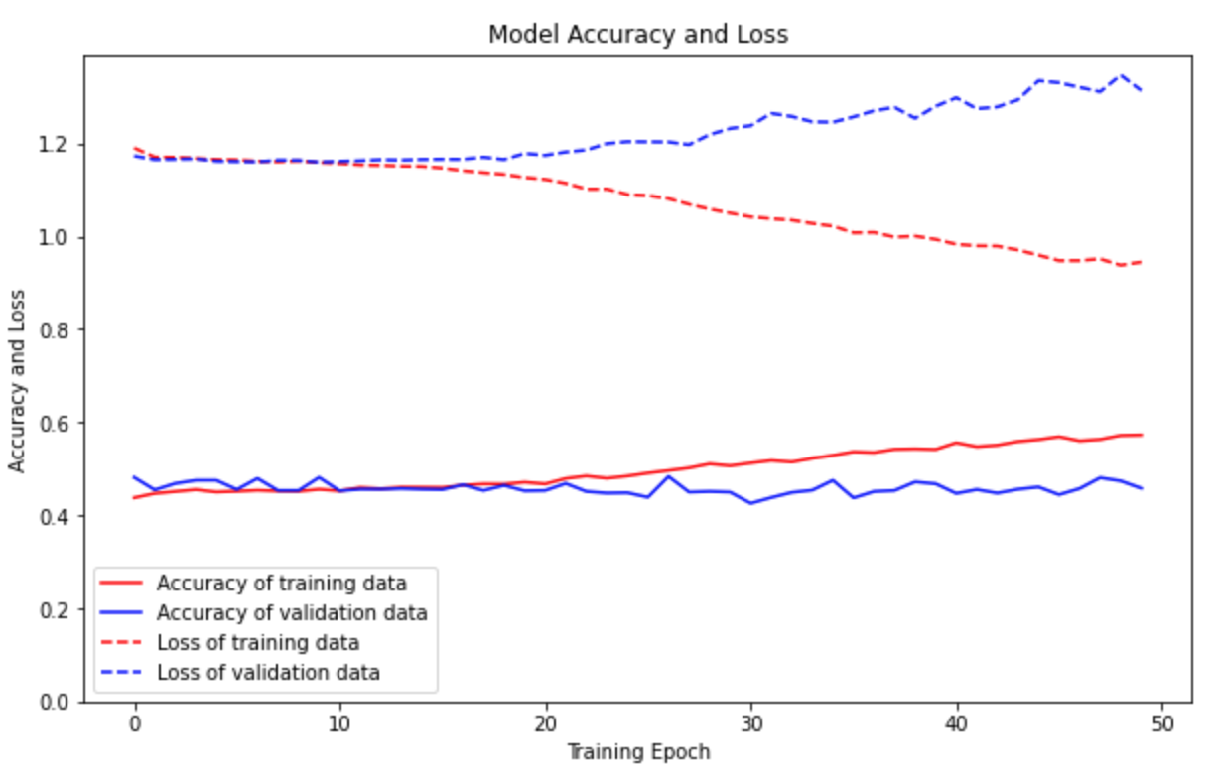
LEARNING METRICS
Feedforward NN
CNN-RNN
Individual Timepoints
Sliding Window
Notes:
To better understand how our models were training, we plotted the training and validation loss and accuracy over epochs. In the feedforward neural net, as epochs increased both the training and validation loss decreased as the accuracy increased.
For the CNN-RNN hybrid model, which takes in windows, we found that with each epoch while the training loss decreased, the validation loss actually increased presenting the idea that the model was overfitting from the get go. This suggests that either the sliding window approach or the CNN-RNN model may not be useful in classifying our data. However, based on previous literature, we believe this not to be the case. We believe that this may be caused by our class imbalance and that using an appropriate oversampling technique or data augmentation may lead to better results.

Slide 20

CHALLENGES & NEXT STEPS

Slide 21
CURRENT CHALLENGES
DATA ISSUES
DATA LOADING
ARCHITECTURE
Imbalance and amount
Finding appropriate ways to input the data so temporal features can be extracted
Determining structure of the model
Notes:
Subject ID issue
Sliding window only works for some model types but not all
Class imbalance and confusion matrix figures if time allows.

Slide 22
NEXT STEPS
DATA LOADER
DATA AUGMENTATION
DIFFERENT ARCHITECTURES
DIFFERENT DATASETS
Properly separate and feed in data by sensor and participant
Synthesize or oversample data
Different structures may be able to extract better features
Testing generalizability
Notes:
Attention or ensemble model
Checking our models with another dataset

Slide 23

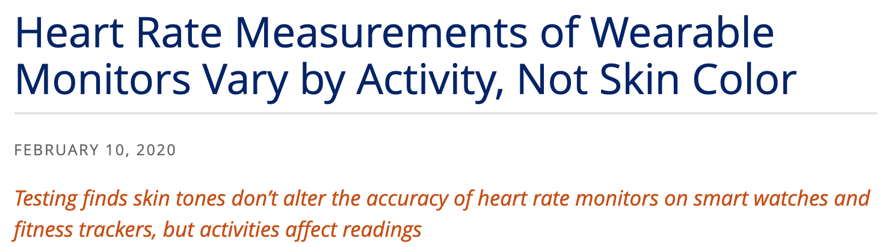

THANKS! ANY QUESTIONS?

Slide 24
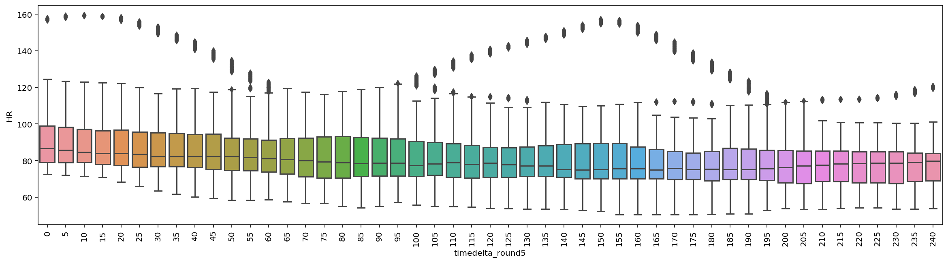
OUTLIER ANALYSIS
Notes:
Either get rid of this or replace it with a couple of select histograms. I think we should have something brief justifying why we didn’t remove any participants based on sensor readings. Also, maybe have a quick sentence about getting rid of apple watches
For all activities, we analyzed subjects as a group to look for individuals that had abnormal readings compared to the rest of the participants. #We also looked at individuals to look for the possibility of sensor malfunction.
We choose to look at sensor data over time as sensors readings change during the course of an activity. I.e. activity, which takes place on a treadmill. The initial reading is taken as a participant goes from a standing to walking state which eventually turns to running.
The plot above shows heart rate during rest where times are rounded to the nearest 5 seconds. Here we observe an individual with abnormal heart rate during rest. While this heart rate is not outside of physiological range for someone who is resting, it is abnormal. Observations such as these have not been removed, but rather, noted incase we see lots of classification errors as we move onto classical machine learning models.

